Slide 1
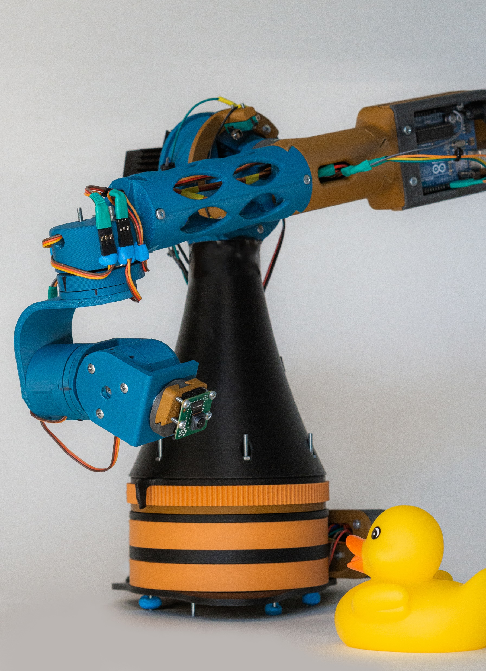
Cinebot Alpha
Course project of
Nikola Totev
for
Practical robotics & Smart Things
Sofia University
July 2020

Slide 2
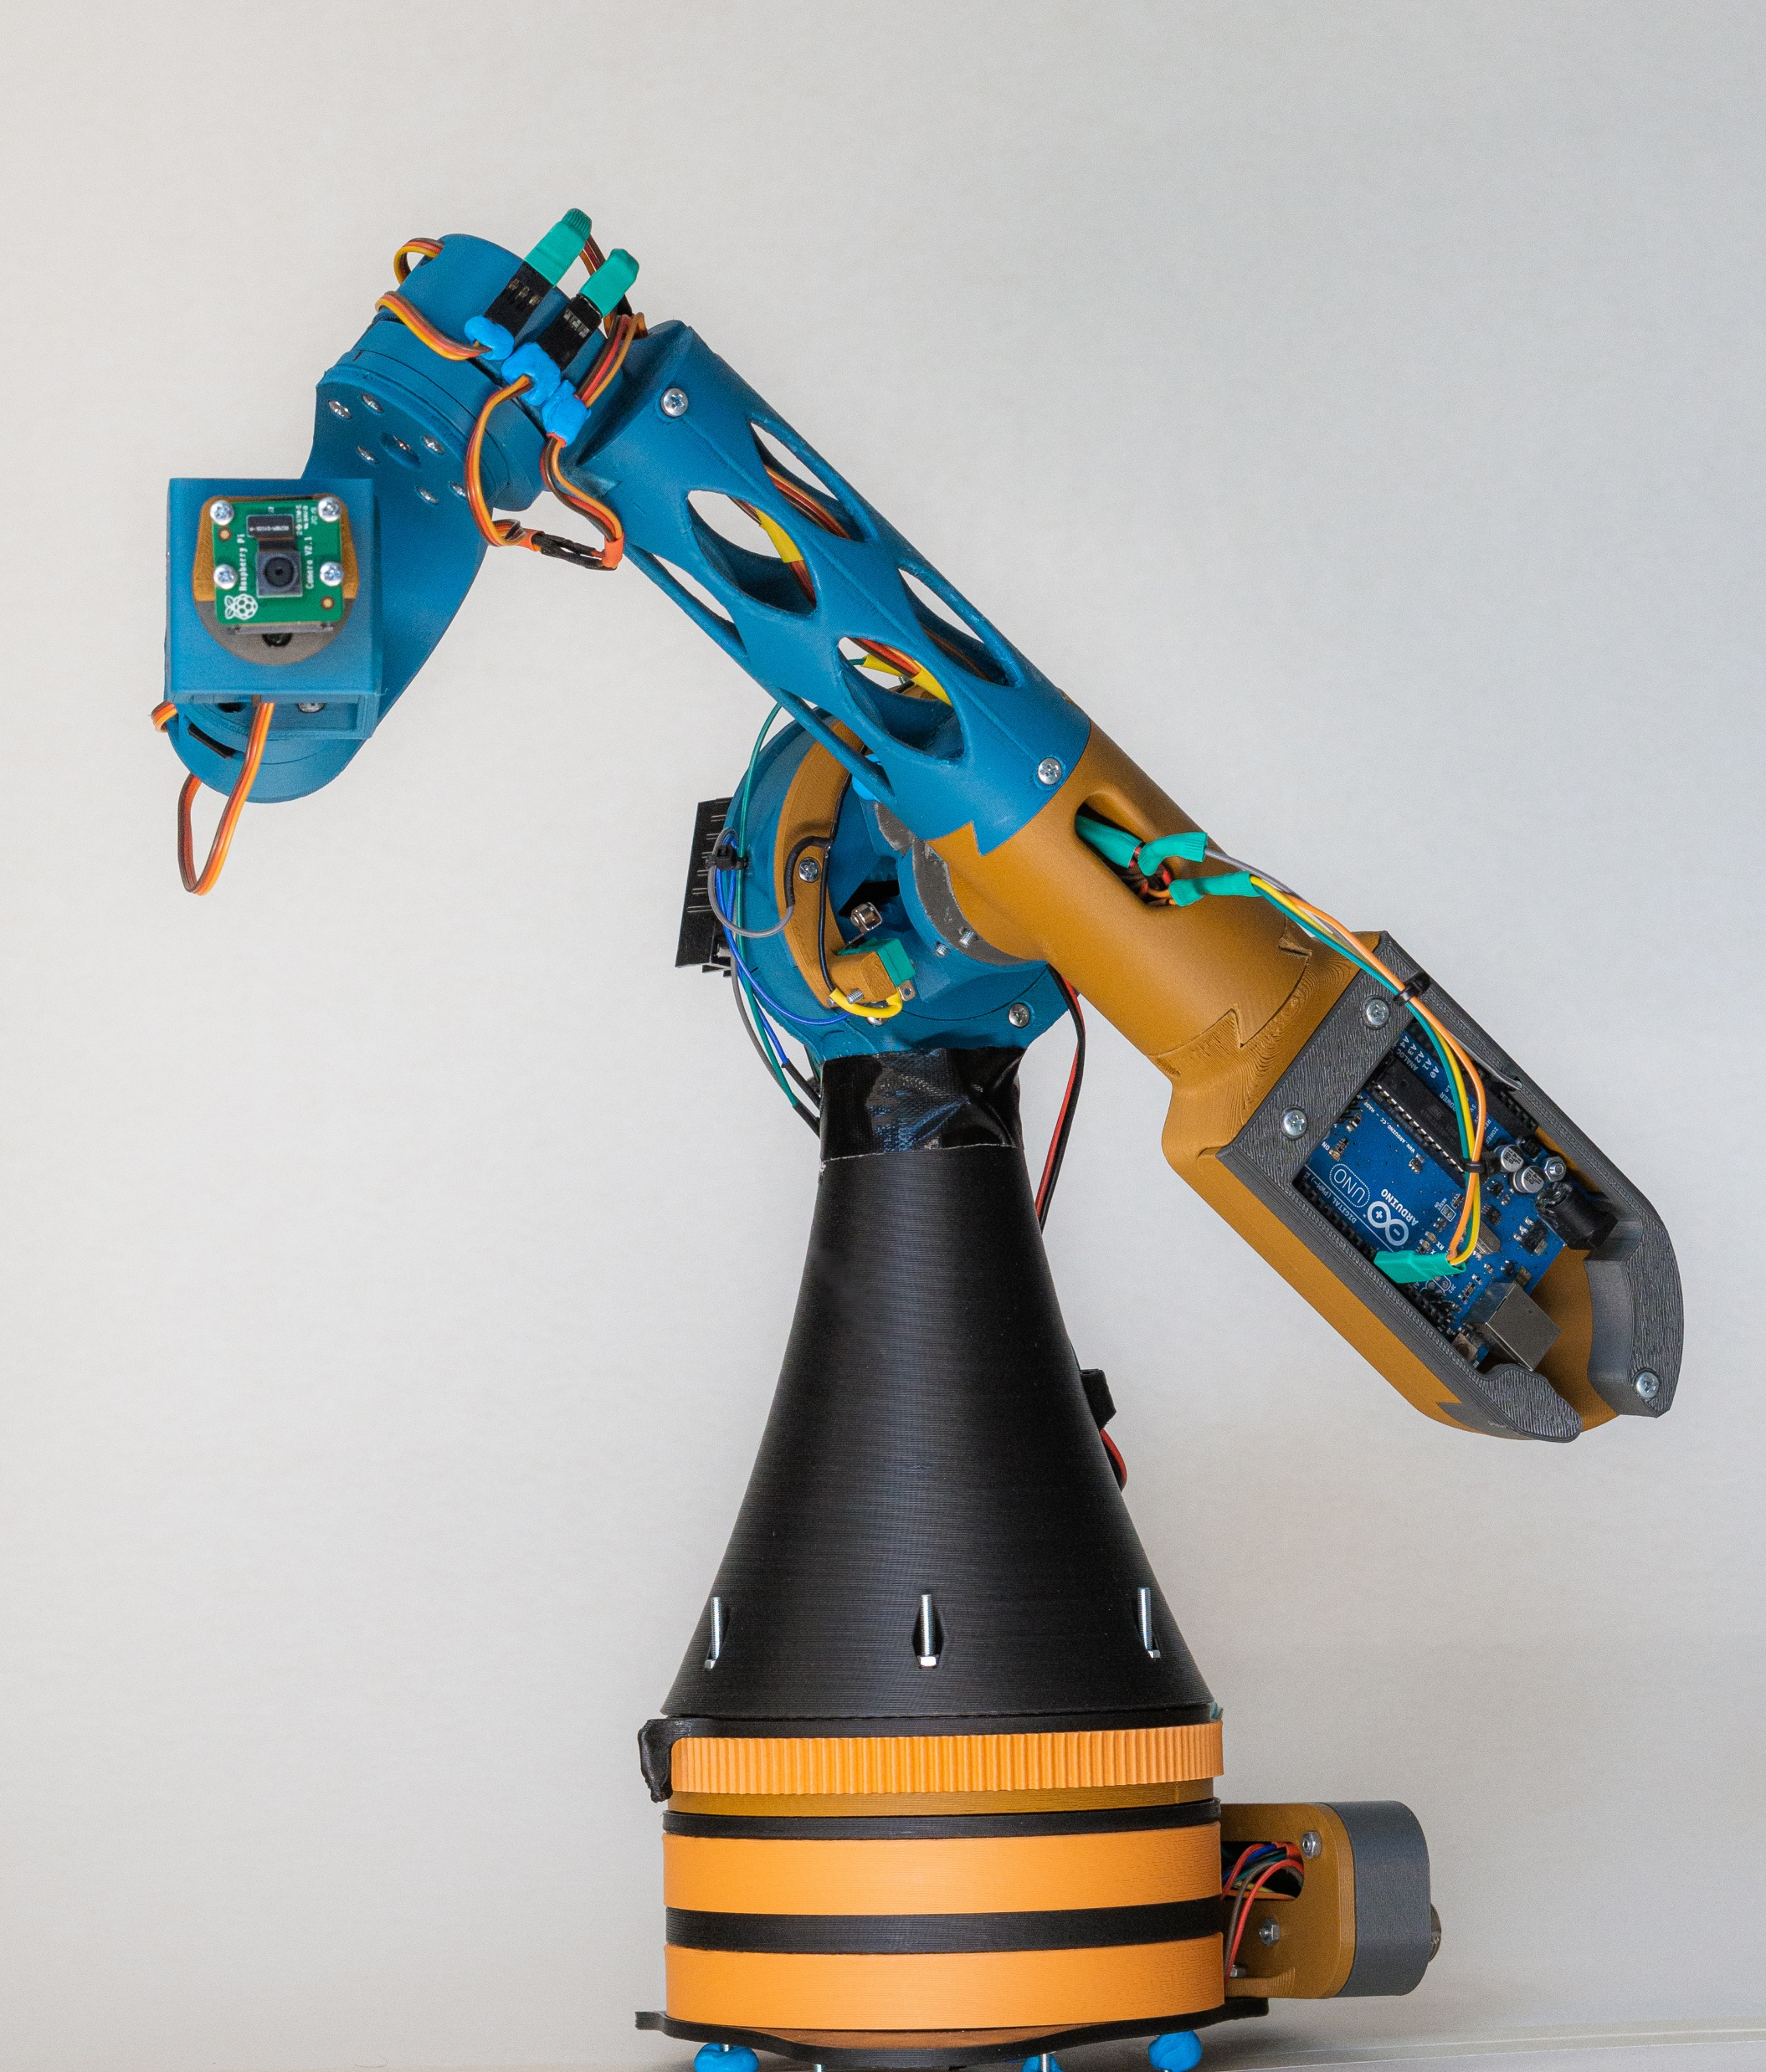
Project overview
Design Concepts
Design challenges
Key features
Used technologies
Development possibilities
Demo

Slide 3
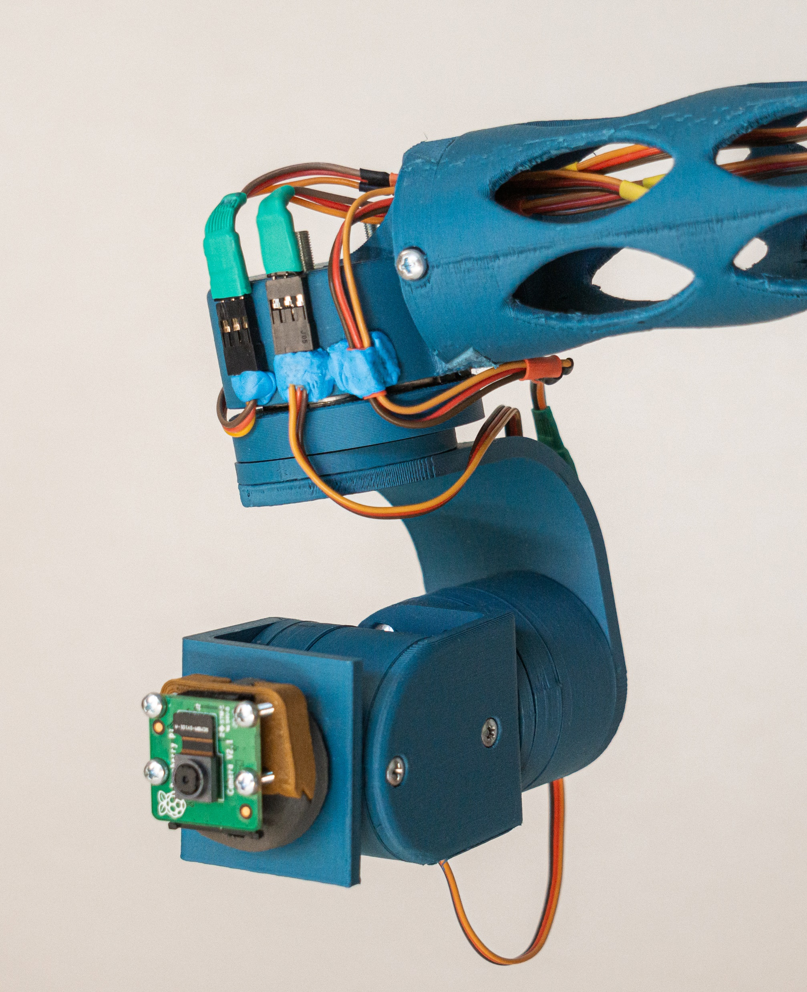
Project overview
What is it?
How is it made?
What can it do?
What can it be used for?

Slide 4
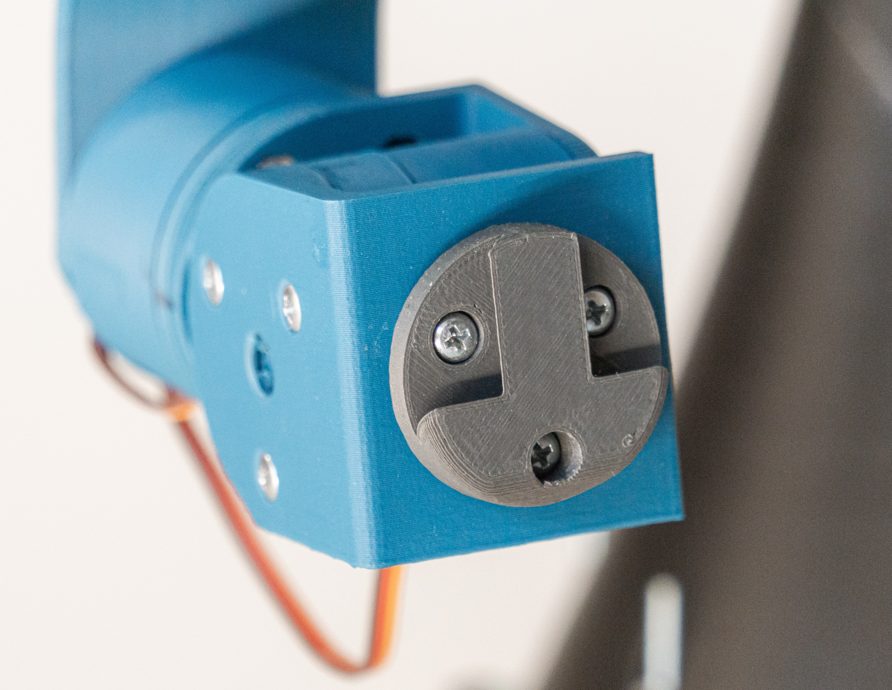
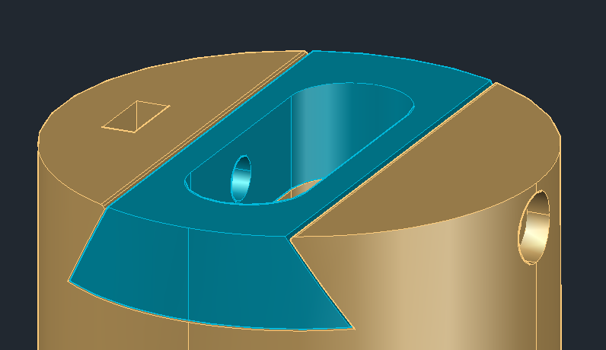
Design Concepts (hardware)
Modularity
Simplicity
3D Printable

Slide 5
Design Concepts (software)
Safety
Modularity
High fault tolerance

Slide 6
Design Challenges (hardware)
No experience with 3D printing or CAD
Unfamiliar with best practices
Lack of knowledge about components

Slide 7
Design Challenges (software)
First time working with Raspberry Pi
No experience programming for Linux
Programming a physical machine
Interprocess communication with UDS
Communication between Rpi & Arduino via Serial

Slide 8
Key Features
Stepper manual move mode (multithreaded)
Gimbal manual move mode
Stepper record mode
Gimbal record mode
Replay mode
Facial tracking (pan only)

Slide 9
Quintic Polynomial Trajectory
What is it?
Why do we need it?
Implementation

Slide 10
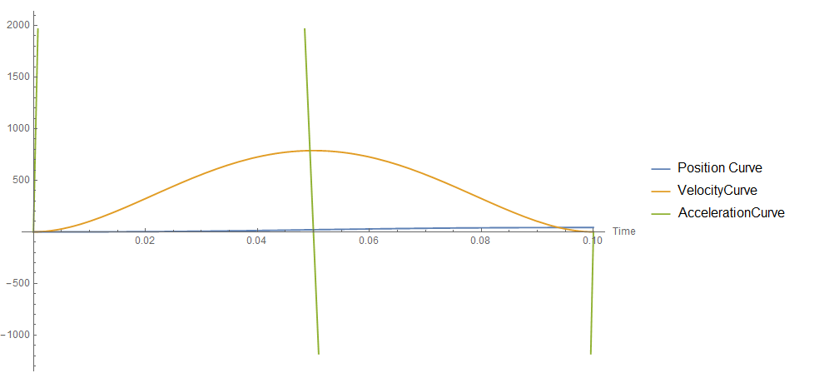

Slide 11
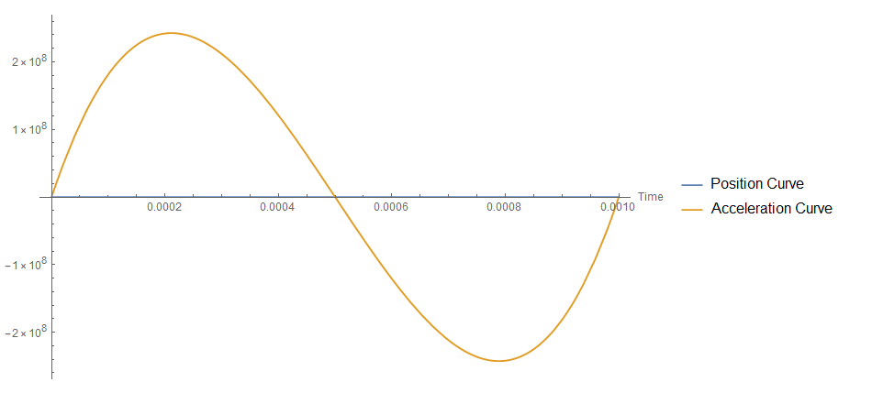

Slide 12
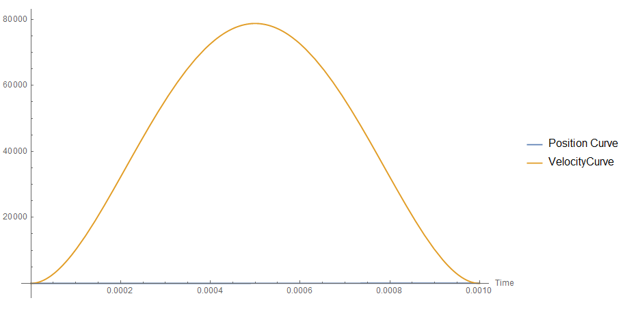

Slide 13
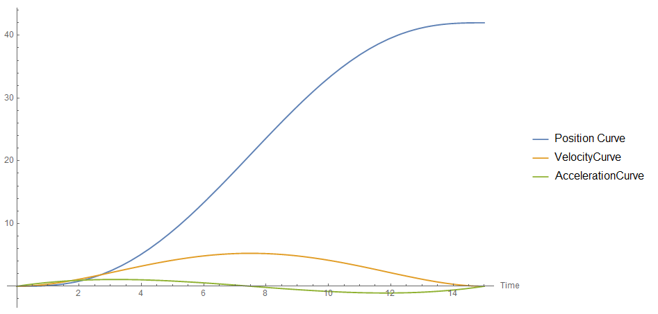

Slide 14
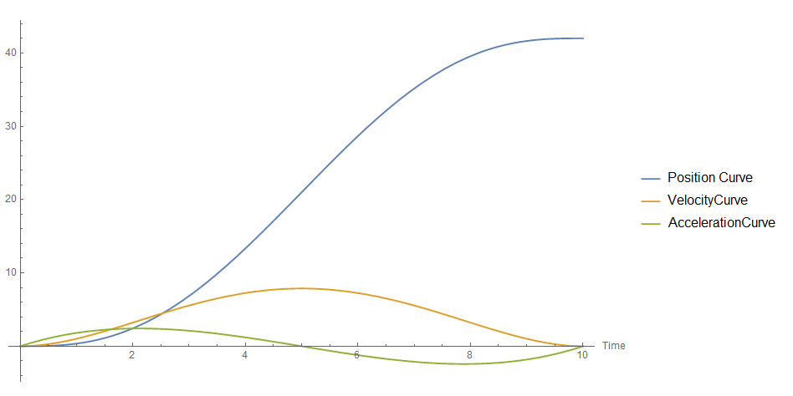

Slide 15
Used technologies
Languages & libraries:
C# - .NET Core, dotnet iot
C
Python
OpenCV
Operating system – Raspbian
Interprocess communication
Unix Domain Sockets

Slide 16
Development possibilities

Slide 17
Time for a demo

